Slide 1
Image Classification Tutorial

Slide 2
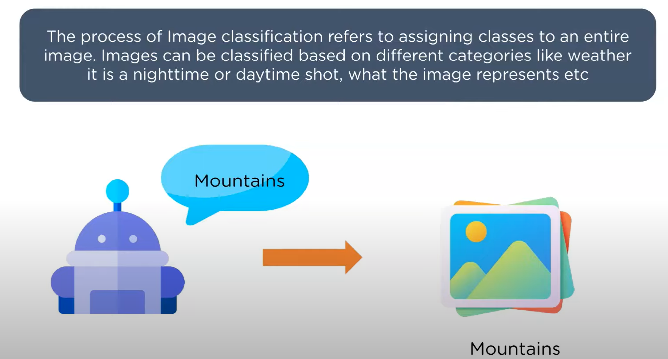
Image classification

Slide 3
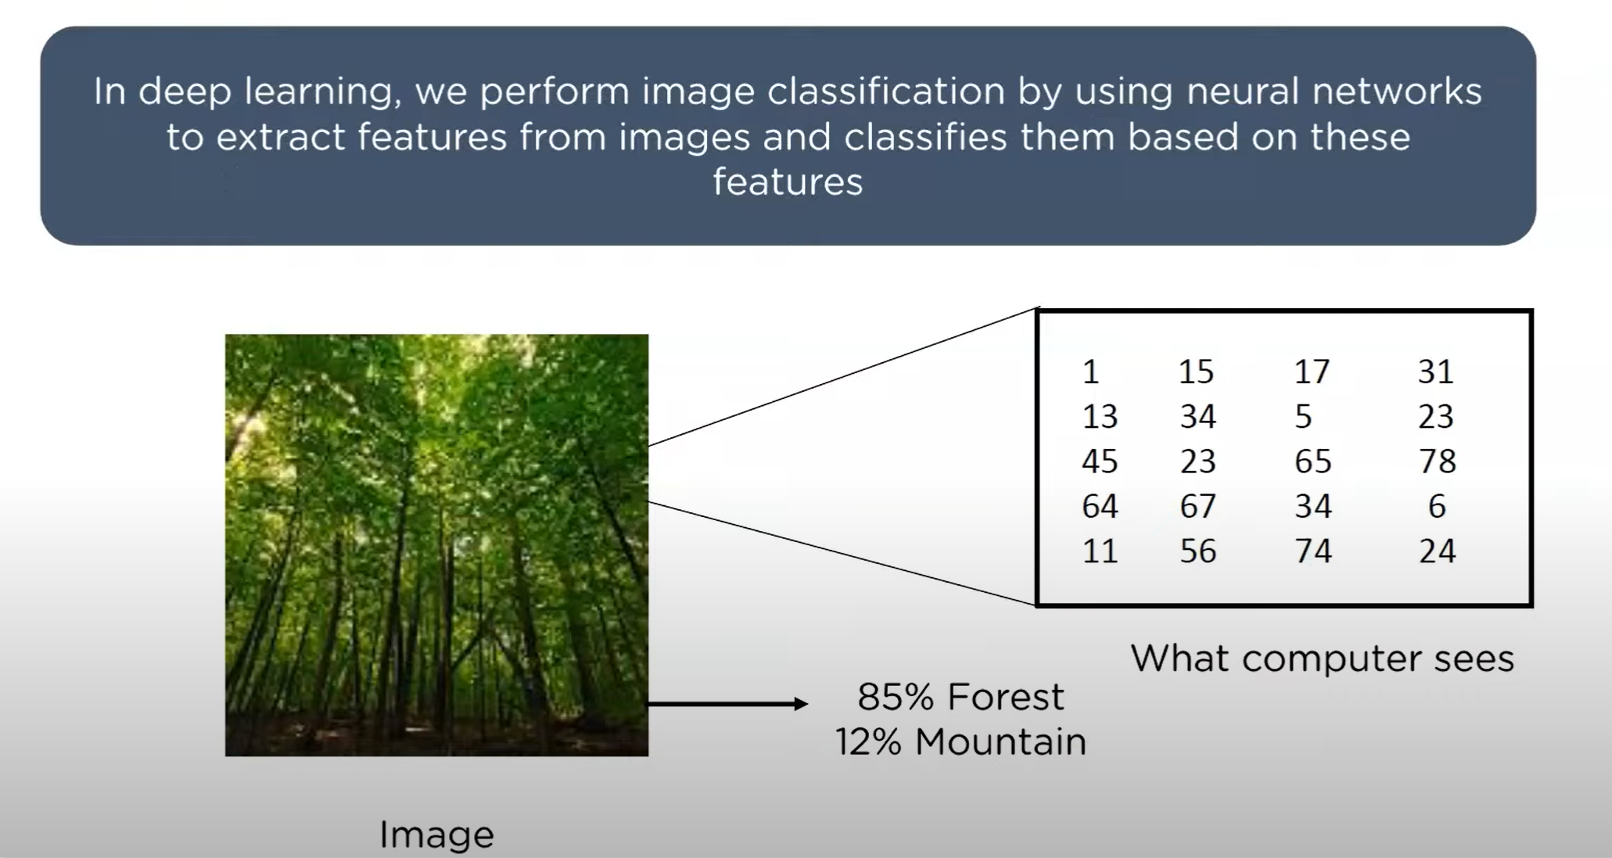
Image classification

Slide 4
Intel Image Classification Data

Slide 5
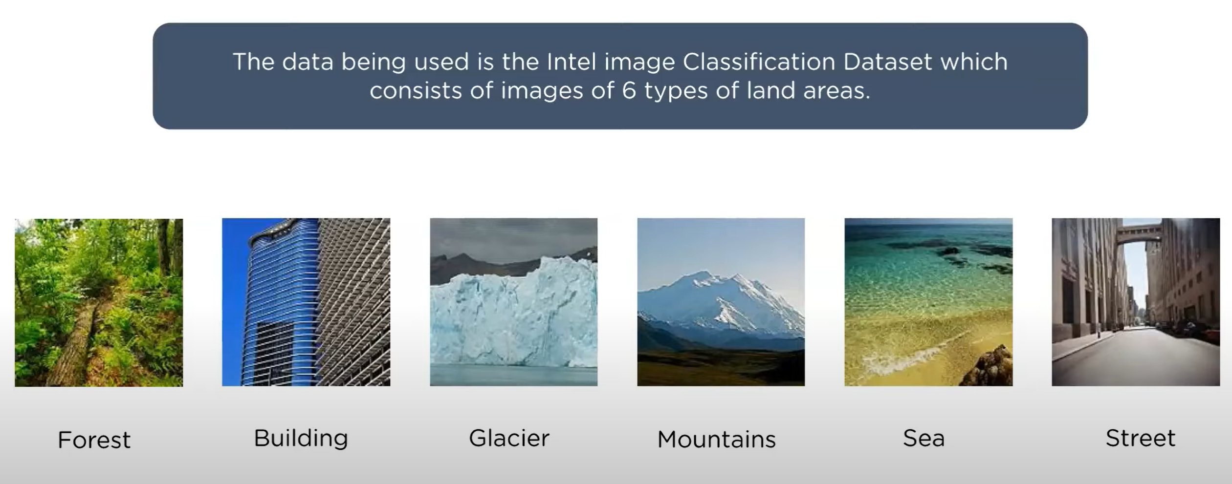
Intel classification data

Slide 6
Tạo Neural Networks với Keras

Slide 7
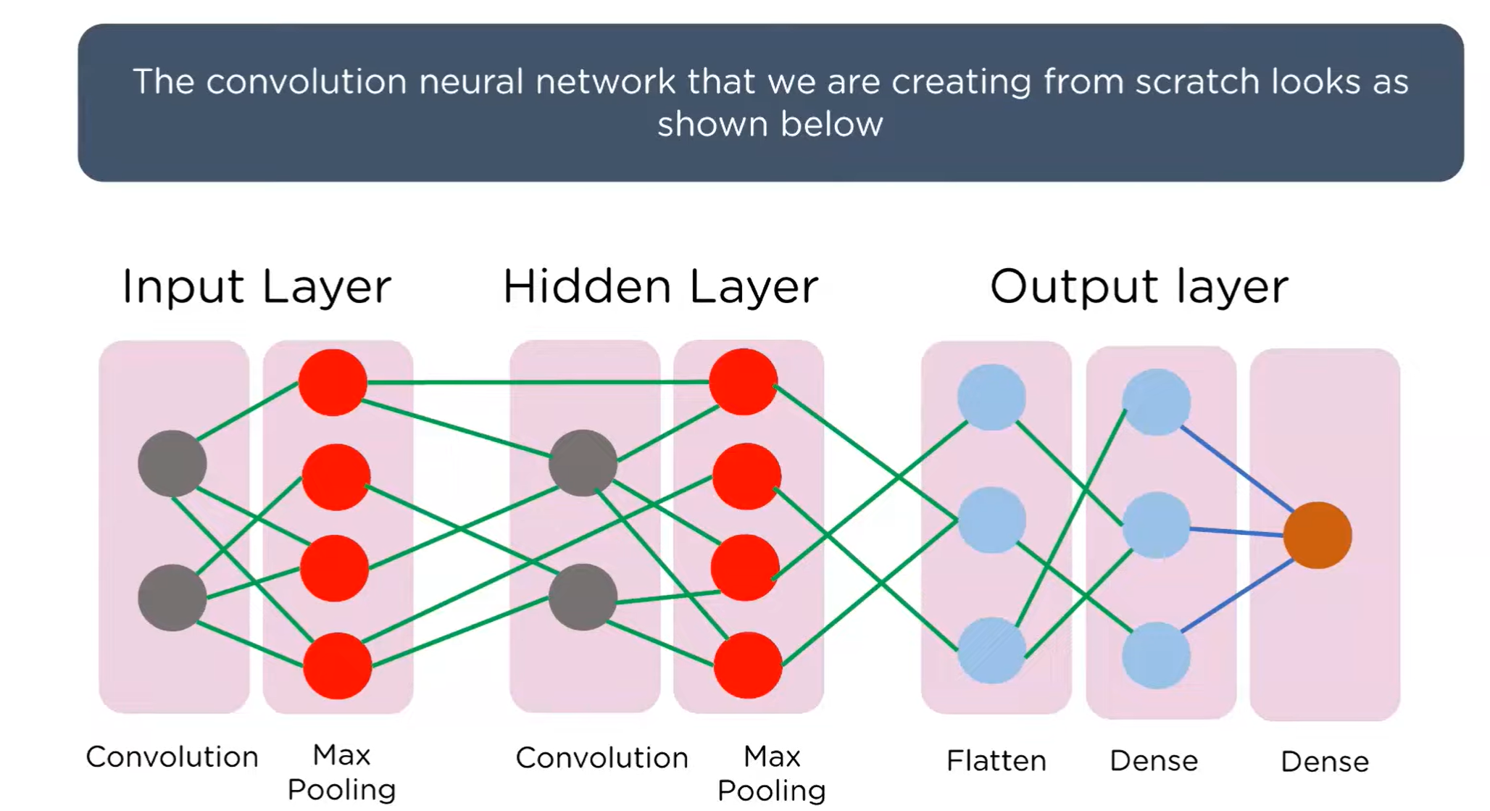
Creating Neural Networks with Keras

Slide 8
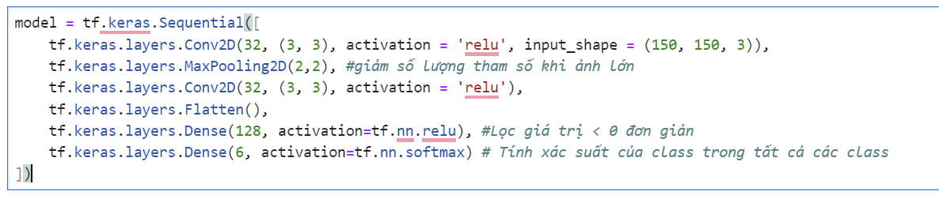
Tạo Neural Networks với Keras

Slide 9
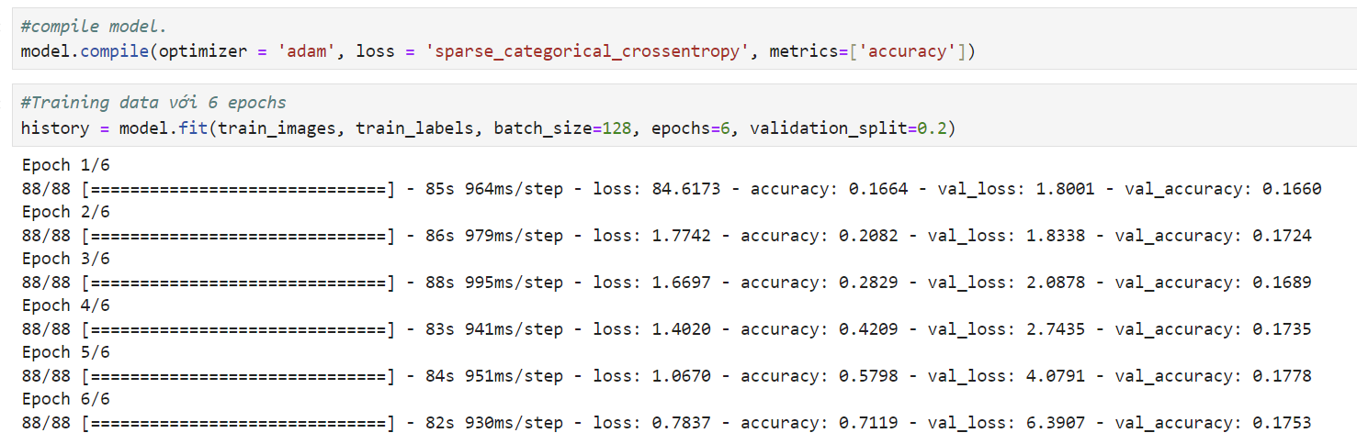
Compile và train model

Slide 10
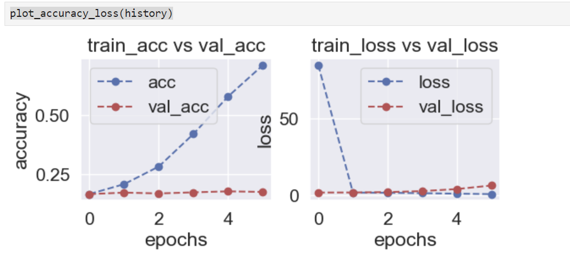

Slide 11
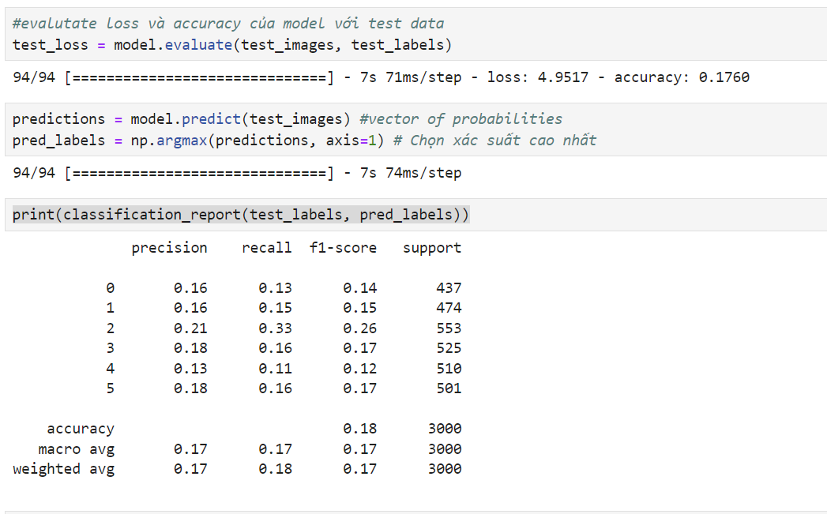
Evaluation và Predict

Slide 12
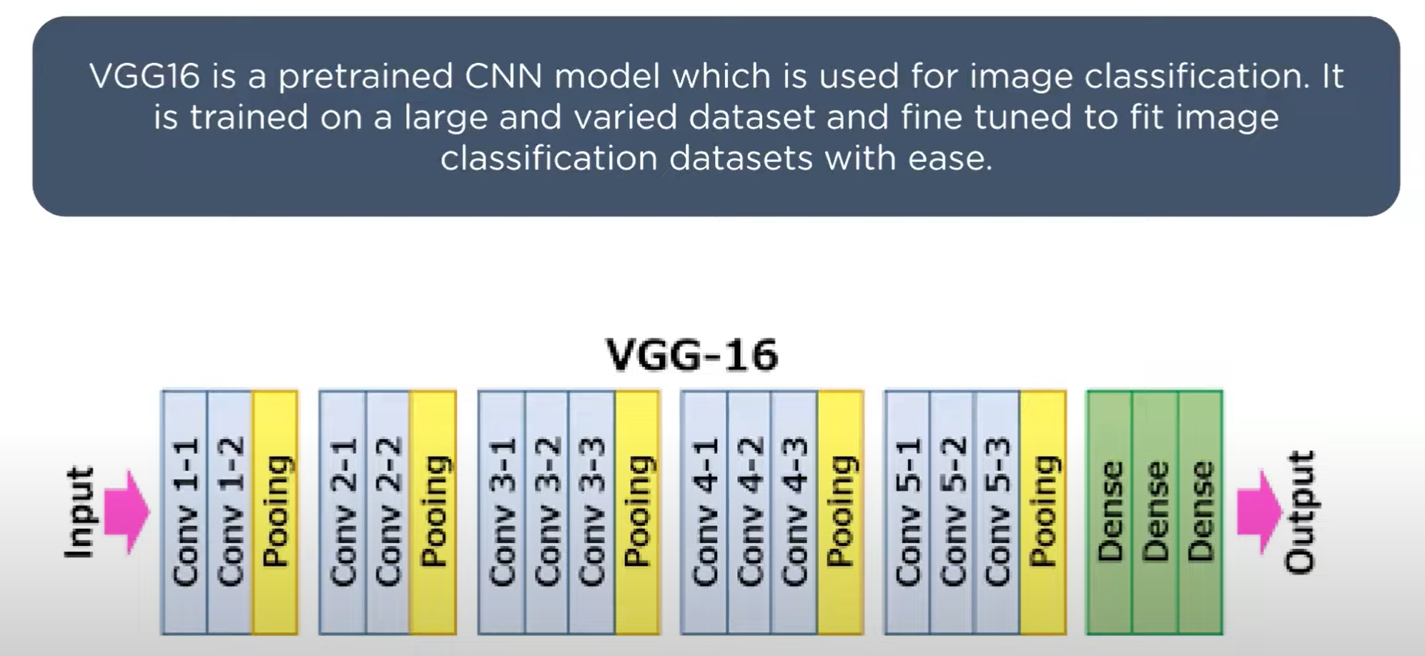
VGG16 Model

